Slide 1

Covid Job Impacts based on US Hiring Data
DEEKSHA UMESH
PRUTHVI KASULA
SHALINI MARNENI
VENKATESHWAR REDDY SANKYAPALLI
GUNAKAR MADDI

Slide 2
Communication plan
Planning and status meetings will be held on Zoom to collaborate work and review deliverables.
Repository created for project: https://github.com/dumesh09/bigdata

Slide 3
Data Selection
Dataset: https://registry.opendata.aws/us-hiring-rates-pandemic/
Documentation of dataset schemas by Greenwich.HR
The Greenwich.HR data platform is the largest and fastest source of real-time labor market data.

Slide 4
Domain Knowledge
This dataset provides daily updates on the volume of US job listings
Data is derived from online job listings tracked continuously, calculated daily, and published nightly.
On average data from 70% of all new US jobs are captured, and the dataset currently contains data from 3.3 million hiring organizations.
Data for each filter segment is represented as the 7-day average of new job listings for a specific date

Slide 5
Data Exploration
The data set is configured into 7 csv files comprising 9.2+MB data.
There are 394393 observations and 6 columns among which 4 attributes are of categorical type and the remaining are numerical attribute and date attribute.
Looking at the columns, the data set provides us information about total number of US job hiring listings in various states, industries (Real estate, Retail, Transportation etc.), job family (Customer Service, Entertainment, Finance etc.), role (Call Center Manager, Actor, CFO etc.) All the columns are not null data fields.

Slide 6
Data Preparation
Handling missing data with imputation or deletion (preferably imputation)
Handling the scaling and normalizing of the data
Visualizing the data inconsistencies to get a better insight in the uniformity or the inconsistencies
Understanding and comparing distribution through histograms, CDF, Q-plots
Visualizing relationships between the variables

Slide 7
Research Objectives
Objective: Overall job market favorability for job seekers
Descriptive questions:
What is the impact on job postings in each state
How different industries have adapted to COVID
Predictive questions:
overall job listings growth

Slide 8
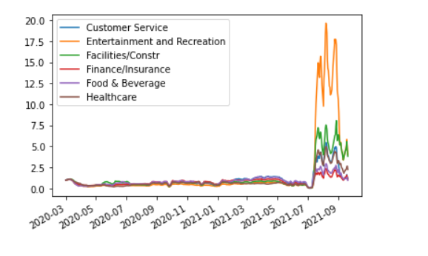
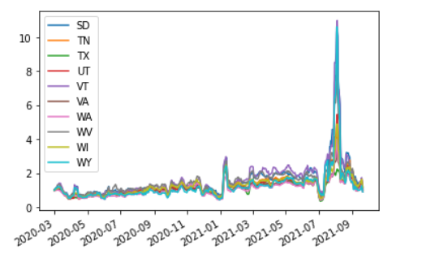
Analytics
Impact on jobs in Impact on jobs in
different industries different locations

Slide 9
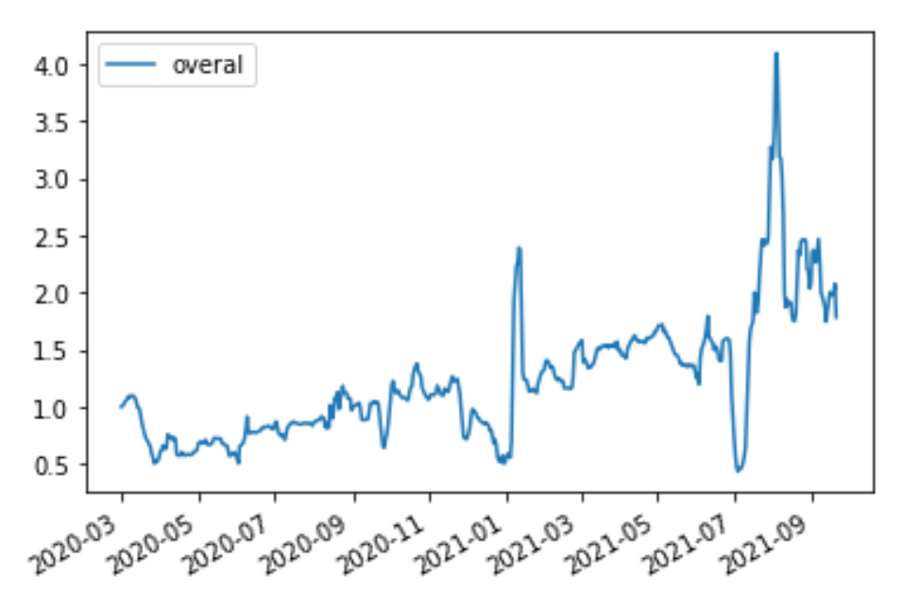
Analytics (contd)
Overall change in the job market in the year 2020-2021 due to covid-19

Slide 10
Evaluation
Our linear regression model gave us accuracy of 71.2%
Evaluation shows improvement in the job market
Optimization
We can optimize our results by exploring multiple regression using different parameters.

Slide 11
Conclusion
The job market appears to be improving, according to the data.
since the number of job posts has nearly quadrupled since March 2020 (pre-covid).
This could be because most people have been vaccinated and are using safeguards like masks and social separation.
As a result, if you're looking for a new job or are just starting out, now is an excellent moment to do it.

Slide 12
Future Work
Capital Ventures to give more insight into the best industries to invest in.
To give insights on the best location and industries for start-ups.
For students who want to pursue their careers, we can give an insight into how each industry is trending in each location and help choose their concentration based on the data.

Slide 13
DATA SPECIFICATION LINK:
HTTPS://GREENWICHHR-COVIDJOBIMPACTS.S3.US-EAST-2.AMAZONAWS.COM/GHR_DATA_SPECS_COVID_PUBLIC.PDF
TOOLS & APPLICATIONS:
COVIDJOBIMPATS.GREENWICH.HR - ONLINE VISUALIZATION OF DAILY HIRING DATA AND WEEKLY UNEMPLOYMENT DATA INCLUDING LINKS TO RECORDED DISCUSSIONS USING THE DATA BY GREENWICH.HR AND ONEMODEL INC.

Slide 14
References:
Dataset: https://registry.opendata.aws/us-hiring-rates-pandemic/
Documentation of dataset schemas by Greenwich.HR
The Greenwich.HR data platform is the largest and fastest source of real-time labor market data.

Slide 15





THANK YOU

